Slide 1
Supervised learning
Xiaofeng Zhu

Slide 2
Outline
Regression
Logistic regression
Decision tree

Slide 3
Machine learning models
Supervised (inductive) learning
Training data includes desired outputs
Unsupervised learning
Training data does not include desired outputs
Semi-supervised learning
Training data includes a few desired outputs
Transfer learning
Training data includes a few outputs unrelated to training data

Slide 4


Machine Learning ≈ Looking for a Function
Speech Recognition
Image Recognition
“How are you”
“Cat”

Slide 5

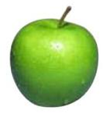
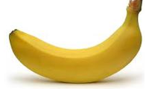
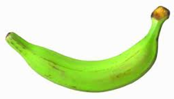
Supervised learning
label
label₁
model/
predictor
label₃
label₄
label₅
Supervised learning: given labeled examples

Slide 6
Classification Techniques
Decision Tree based Methods
Rule-based Methods
Neural Networks
Naïve Bayes and Bayesian Belief Networks
Support Vector Machines
… …
Notes:
In machine learning, many techniques have been used to find the map between input and output, such as
Different methods have different methods to obtain the map, but most of classification techniques are similar for predicting the unseen data with the learnt map.

Slide 7
Machine learning framework
Y = f(x)
Training: given a training set of labeled examples {(x₁,y₁), …, (x_{n},y_{n})}, estimate the prediction function or objective function or cost function f by minimizing the prediction error on the training set
Testing: apply f to a never before seen test example x and output the predicted value Y = f(x)
If Y is continuous value, the prediction process to obtain f(X) is called regression. If Y is discrete value, the prediction process to obtain f(X) is called classification.
Feature
output
objective function

Slide 8
Machine Learning is so simple ……
Step 1: define a set of function
Step 2: goodness of function
Step 3: pick the best function

Slide 9
Least square
Given is a bivariate dataset (x1, y1), …, (xn, yn), where x1, …, xn are nonrandom and Yi = α + βxi + Ui are random variables for i = 1, 2, . . ., n. The random variables U1, U2, …, Un have zero expectation and variance σ ²
Method of Least Squares: Choose a value for α and β such that
S(α,β)=( ) is minimal.

Slide 10
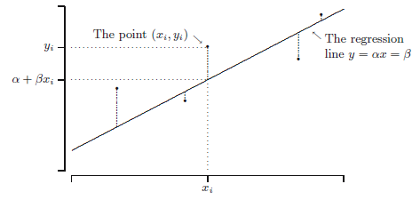
Least square
The observed value y_{i} corresponding to x_{i} and the value α+βx_{i} on the
regression line y = α + βx.

Slide 11
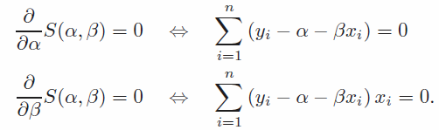
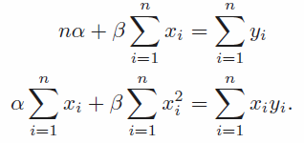
Estimation
Method of Least Squares: Choose a value for α and β such that
S(α,β)=( ) is minimal.
To find the least squares estimates, we differentiate S(α, β) with respect to α and β, and we set the derivatives equal to 0:
After some calculus magic, we get two equations to estimate α and β:

Slide 12
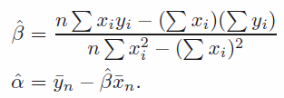
Estimation
After some simple algebraic rearranging, we obtain:
(slope)
(intercept)

Slide 13
Define a linear function
Simplest equation that describes the dependence of variable or output y on input X
is the slope vector

Slide 14
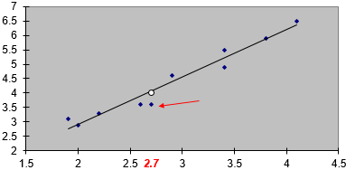
Searching a least squares prediction line to pass all points

Slide 15
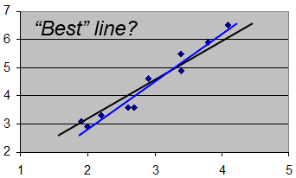
Goodness of functions

Slide 16
Pick the best function
How to get that can minimize the sum of squares of errors?
Gradient descent & convex optimization

Slide 17

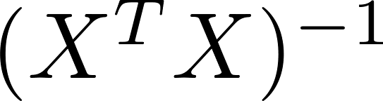
Pick the best function
n training examples, m features
Gradient descent
Convex optimization
Need to choose .
Needs many iterations.
No need to choose .
Don’t need to iterate.
Need to compute
Slow if m is very large.
Works well even when m is large.

Slide 18
Outline
Regression
Logistic regression
Decision tree

Slide 19
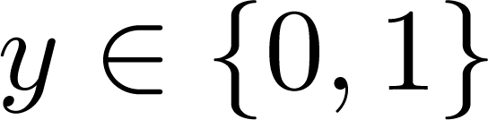
Logistic regression
Email: Spam / Not Spam?
Online Transactions: Fraudulent (Yes / No)?
Tumor: Malignant / Benign ?
0: “Negative Class” (e.g., benign tumor)
1: “Positive Class” (e.g., malignant tumor)
Threshold classifier output at 0.5:
If f(x) is larger than 0.5 , predict “y = 1”
If f(x) is not larger than 0.5 , predict “y = 0”

Slide 20
Outline
Regression
Logistic regression
Decision tree

Slide 21
Decision Tree
There could be more than one tree that fits the same data!
categorical
categorical
continuous
class
Splitting features
Refund
Yes
No
NO
MarSt
Single, Divorced
Married
TaxInc
NO
< 80K
> 80K
NO
YES
Training Data
Model: Decision Tree
Notes:
Given a training data, the input or feature vectors can be categorical feature, continuous feature, and the output often is categorical features.
Decision tree uses a tree (binary tree or multi-way tree to build the map between input and output like the right figure, where each yellow node represents a feature and the blue leaf node is the output, the branch of each node is the node’s feature value, such as there are two feature values (yes, no) for the feature or the node refund
We call the yellow node as splitting feature.
Normally, different feature can be selected as the root node so that we may obtain many decision trees, like

Slide 22
Another Example of Decision Tree
categorical
categorical
continuous
class
MarSt
Single, Divorced
Married
NO
Refund
Yes
No
NO
TaxInc
< 80K
> 80K
NO
YES
Which tree is the best one?
If we have a best choice, how to build it?
How to use the decision tree to predict test subjects?
Notes:
So we make ask a question which decision tree is the best one? How to select the root node. How to use the decision tree to predict the output of a given test subject?

Slide 23
Apply Model to Test Data
Test Data
Start from the root of tree.
Refund
Yes
No
NO
MarSt
Single, Divorced
Married
TaxInc
NO
< 80K
> 80K
NO
YES

Slide 24
Apply Model to Test Data
Test Data
Refund
Yes
No
NO
MarSt
Single, Divorced
Married
TaxInc
NO
< 80K
> 80K
NO
YES

Slide 25
Apply Model to Test Data
Test Data
Refund
Yes
No
NO
MarSt
Single, Divorced
Married
TaxInc
NO
< 80K
> 80K
NO
YES

Slide 26
Apply Model to Test Data
Test Data
Refund
Yes
No
NO
MarSt
Single, Divorced
Married
TaxInc
NO
< 80K
> 80K
NO
YES

Slide 27
Apply Model to Test Data
Test Data
Refund
Yes
No
NO
MarSt
Single, Divorced
Married
TaxInc
NO
< 80K
> 80K
NO
YES

Slide 28
Apply Model to Test Data
Test Data
Refund
Yes
No
NO
MarSt
Single, Divorced
Married
Assign Cheat to “No”
TaxInc
NO
< 80K
> 80K
NO
YES

Slide 29
Decision Tree ?
Decision Tree
Which tree is the best one?
If we have a best choice, how to build it?

Slide 30
Another Example of Decision Tree
MarSt
Single, Divorced
Married
NO
Refund
Yes
No
NO
TaxInc
< 80K
> 80K
NO
YES
(1) Which to start? (root)
(2) Which node to proceed?
Notes:
The key issue is to select the root node and then select other to proceed for building the tree.
Obviously, exhaustive search is the best one. However, this is NP-complete issue. The alternative solution is greedy search strategy. That is, using heuristic strategy will be used. Such method include ID3, C4.5, and CART,

Slide 31
Decision Trees
ID3 (Iternative Dichotomizer)
C4.5
CART (Classification and Regression Trees)
Greedy search algorithms with different splitting criteria so that no global solution
Notes:
The key difference among them is the splitting criteria

Slide 32
Splitting Criteria
Entropy
information gain for ID3
gain ratio for C4.5
Gini index for CART
Notes:
The popular splitting criteria is entropy and gini index

Slide 33
Entropy
Entropy at a given node t:
(p( j | t) is the frequency of class j at node t).
Measures homogeneity of a node.
Maximum (log n_{c}) when subjects are equally distributed among all classes implying least information or maximal uncertainty
Minimum (0.0) when all subjects belong to one class, implying most information or least uncertainty
Entropy based computations are similar to the GINI index computations
Notes:
The entropy at the node t is the negative summation of the product of the frequency of each class at the node t and the log operator of this frequency.
Specifically, p(j|t) is the frequency of class j at node t

Slide 34
Entropy
Is this person a professional players | Height | Dexterity | Fitness
yes | tall | good | very fit
no | short | bad | unfit
no | tall | bad | fit
no | short | bad | unfit
no | tall | good | fit
no | short | good | unfit
no | tall | bad | very fit
no | short | bad | fit
yes | short | good | very fit
no | short | bad | very fit
P(yes) = 2/10
P(no) = 8/10
Entropy = – 0.2 log 0.2 – 0.8 log 0.8
= 0.722
Notes:
The entropy calculates the uncertainty of the output. The large the value of entropy, the larger the uncertainty is.
For example, if all the labels are evenly distributed, either yes or no is appeared at the same number of subjects, than the entropy is 1. In this case, it is very difficult to judge the output of a test subject
If only having one class, the entropy will be 0, in this case, the uncertainty is minimal because we definitely know the output of the subject
P(yes) means the frequency of the class yes at all the subjects

Slide 35
Information gain
Information Gain:
Parent Node, p is split into k partitions;
k is the number of feature values
n_{i} is number of subjects in partition i
Measures Reduction in Entropy achieved because of the split. Choose the split that achieves most reduction (maximizes GAIN)
Used in ID3 and C4.5
Disadvantage: Tends to prefer splits that result in large number of partitions, each being small but pure.
Notes:
To select the splitting feature, only entropy of output is not enough. The entropy at features of input should be considered as well. Therefore, information gain combing them has been used in ID3.
Information gain is the difference between the entropy of the parent node and the entropy of the summation of the child nodes.

Slide 36
Information gain
Is this person a professional players | Height | Dexterity | Fitness
yes | tall | good | very fit
no | short | bad | unfit
no | tall | bad | fit
no | short | bad | unfit
no | tall | good | fit
no | short | good | unfit
no | tall | bad | very fit
no | short | bad | fit
yes | short | good | very fit
no | short | bad | very fit
P(yes) = 2/10 P(no) = 8/10
Entropy = – 2/10 log 2/10 – 8/10 log 8/10
= 0.722
Is this person a professional players | Height
yes | tall
no | tall
no | tall
no | tall
Entropy (H_{tall}) = – 1/4 log 1/4 – 3/4 log 3/4 = 0.811
Is this person a professional players | Height
no | short
no | short
no | short
no | short
yes | short
no | short
Entropy (H_{short}) = – 1/6 log 1/6 – 1/6 log 1/6 = 0.650
Gain(Height) = Entropy - 4/10* 0.811-6/10*0.650=0.0076
Notes:
The first term is the entropy of the output
How to calculate the entropy of other features.
Firstly, we partition the feature based on its feature values, such as Height has two values, tall and short
To calculate the entropy of the tall value, we only focus on the first column and to obtain the results
With the same principle, we calculate the entropy of the short value
Besides, we also need to know the frequency of each feature values on the dataset, such as 4 for tall and 6 for short.
After this, we obtain the information gain of the potential splitting feature as

Slide 37
Information gain
Is this person a professional players | Height | Dexterity | Fitness
yes | tall | good | very fit
no | short | bad | unfit
no | tall | bad | fit
no | short | bad | unfit
no | tall | good | fit
no | short | good | unfit
no | tall | bad | very fit
no | short | bad | fit
yes | short | good | very fit
no | short | bad | very fit
P(yes) = 2/10 P(no) = 8/10
Entropy = – 2/10 log 2/10 – 8/10 log 8/10 = 0.722
Gain(Height) = Entropy - 4/10* 0.811-6/10*0.650=0.0076
Gain(dexterity) = 0.322
Gain(fitness) = 0.322
Notes:
In the same way, we may obtain the information gain of other two features, such as dexterity and fitness.
We select the features with the maximal information gain to be the splitting feature, here either dexterity and fitness.

Slide 38
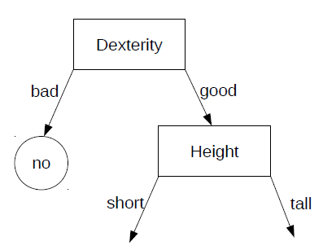
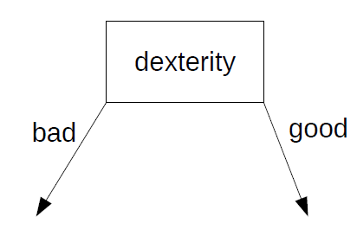
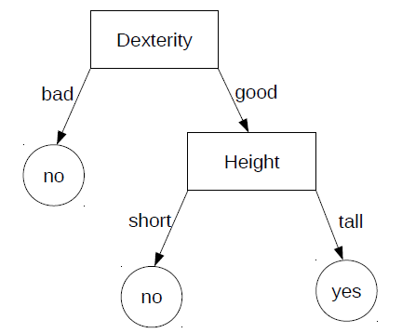
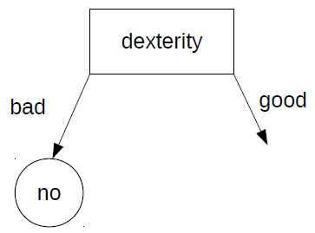
Is this person a professional players | Height | Dexterity | Fitness
yes | tall | good | very fit
no | short | bad | unfit
no | tall | bad | fit
no | short | bad | unfit
no | tall | good | fit
no | short | good | unfit
no | tall | bad | very fit
no | short | bad | fit
yes | short | good | very fit
no | short | bad | very fit
Notes:
After this, we split the feature dexterity into two branches based its two feature values, good and bad.
In the left brank, all subjects are the same labels, no, so it is regarded as the leaf node. However, there are two different classes in the right branch. Hence, we continue to select splitting features from the left features to further build the tree.
We use the same way to partition each node by selecting splitting features in the left features until the stop criteria achieved, such as pure subjects in one node, no features, no samples.
The node with pure subjects will be assigned the class directly, otherwise, use the majority rule.
ID3 tends to prefer splits that result in large number of partitions, each being small but pure, such as fitness will be selected firstly.

Slide 39
GainRATIO
Gain Ratio:
Parent Node, p is split into k partitions (feature P has k feature values)
n_{i} is the number of subjects in partition i
Adjusts Information Gain by the entropy of the partitioning (SplitINFO). Higher entropy partitioning (large number of small partitions) is penalized!
Used in C4.5
Designed to overcome the disadvantage of Information Gain
Notes:
To solve this issue, C4.5 use Gain ration to replace information gain in ID3.
Specifically, gain ration uses information gain as its numerator, and adds splitINFO as its denominator.
We leave the detail of C4.5 to you. If you are interested in this, please read the books on machine learning and data mining.

Slide 40
Gini Index
Gini Impurity or Gini index for a given node t :
(NOTE: p( j | t) is the frequency of class j at node t).
Maximum (1 - 1/n_{c}) when records are equally distributed among all classes, implying least interesting information
Minimum (0.0) when all records belong to one class, implying most interesting information
Notes:
Both ID3 and C4.5 are designed for binary tree and multi-way tree. However, CART use different splitting criteria (here Gini index) to build binary trees.
Here is the definition of Gini index, which is similar to the computation of Entropy.
Gini index is the frequency times frequency, while Entropy is frequency times the log operator to the base 2 of the frequency.

Slide 41
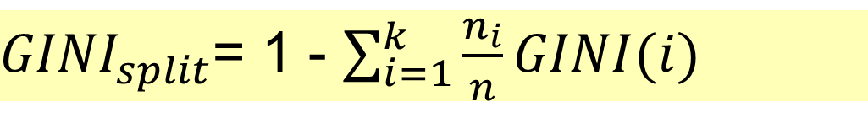
Gini Gain
Used in CART, SLIQ, SPRINT.
When a node p is split into k partitions (children), the quality of split is computed as,
where, n_{i} = number of subjects at child i,
n = number of subjects at node p.
Notes:
Moreover, Gini gain is similar to the computation of information gain, where both of them need to calculate the frequency of each class in all the subjects at node t, such as n_i/n
More detail of computation on Gini gain can be found in the PDF-based supplementary materials.

Slide 42
Difference of decision trees
 | Splitting criteria | Feature type | Missing values | Prune strategy | Outlier detection
ID3 | Information gain | Categorical | No | No | Susceptible to outliers
C4.5 | Gain ratio | Categorical & Numeric | Yes | Error-based | Susceptible to outliers
CART | Gini impurity | Categorical & Numeric | Yes | Cost-complexity | Handle outliers
Notes:
We have the difference among three decision trees

Slide 43
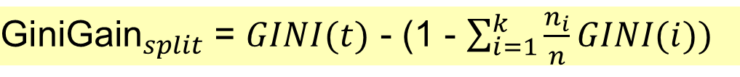
Difference of Entropy and Gini index
Notes:
And the difference between the Entropy and Gini index
After this slides, we will focus on encoding part by jupyter notebook, where we will do exercises on decision trees.

